Slide 1


Intune Custom Compliance Magic
Liviu Barbat
Twitter - @LeeViewB
LinkedIn

Slide 2

Intune Custom Compliance Magic
Agenda:
Getting to Know Microsoft Intune.
The Vital Role of Device Compliance.
Crafting Your Custom Device Compliance Policies.
Strategies for Policy Success.
Real-time Monitoring and Enforcement.
Learning from Real-life Examples.
Time for Your Questions.

Slide 3
Intune Custom Compliance Magic
1. What is Microsoft Intune?
Microsoft Intune as a cloud-based device management and security solution.
Simply put, among it’s features we have device management, application management, and security.

Slide 4
Intune Custom Compliance Magic
2. The Vital Role of Device Compliance
Device compliance is important for security and data protection.
Non-compliant devices are at risk.
Device compliance rules can help protect organizational data by requiring users and devices to meet some requirements

Slide 5
Intune Custom Compliance Magic
3. Device compliance settings
Microsoft pre-configured some settings for you to enable.
Password length, password expiration, minimum OS version, etc
With Conditional Access you can block access to resources if devices don’t meet the defined compliance criteria.
Another option to configure actions for noncompliance (send email to user, retire the device…)
There aren’t a lot of pre-configured settings.

Slide 6
Intune Custom Compliance Magic
4. Custom device compliance policies
Custom compliance policies can be created. Two essential prerequisites:
A PowerShell Script – your settings discovery script.
JSON file – contains your custom settings. Based on this the policy determines whether the device is compliant or not.
Upside: you can do anything you can think of with a script
Downside: custom policies only supported on Windows and Linux.

Slide 7
Intune Custom Compliance Magic
4. Custom device compliance policies
The scripts can be anything you want. They cannot exceed 1MB and results must be compressed in a single line.
This line would have to be at the end of your script:
return $hash | ConvertTo-Json –Compress
Examples can be found here: https://github.com/LeeViewB/CheckComplianceScripts

Slide 8
Intune Custom Compliance Magic
4. Custom device compliance policies
The JSON must be formatted like this:
{
"Rules":[
{
"SettingName":"Google Chrome Installed",
"Operator":"IsEquals",
"DataType":"Boolean",
"Operand":false,
"MoreInfoUrl":"https://www.liviubarbat.info",
"RemediationStrings":[
{
"Language": "en_US",
"Title": "Google Chrome x64 is installed.",
"Description": "Please uninstall this software"
}
]
}
}

Slide 9
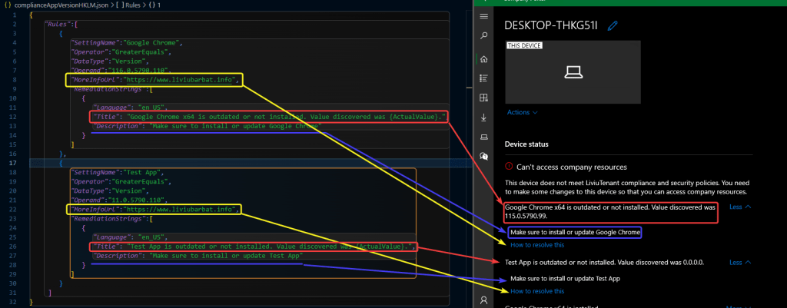
Intune Custom Compliance Magic

Slide 10
Live Demo!

